Slide 1
PLASMA CELL DISORDERS
Dr. GOPIKA .R.S. M.D. (Hom.)
Professor & HoD
Dept. of Pathology & Microbiology

Slide 2
The plasma cell disorders are characterised by abnormal proliferation of immunoglobulin-producing cells and result in accumulation of monoclonal immunoglobulin in serum and urine.

Slide 3
The group comprises the following six disease entities:
1. Multiple myeloma
2. Localised plasmacytoma
3. Lymphoplasmacytic lymphoma)
3. Waldenström’s macroglobulinaemia
4. Heavy chain disease
5. Primary amyloidosis
6. Monoclonal gammopathy of undetermined significance (MGUS).

Slide 4
The feature common to all plasma cell disorders is the neoplastic proliferation of cells derived from B-lymphocyte lineage.
Bence-Jones proteins are free light chains present in blood and excreted in urine of some plasma cell disorders.

Slide 5
MULTIPLE MYELOMA
Multiple myeloma is a multifocal malignant proliferation of plasma cells derived from a single clone of cells (i.e. monoclonal).
Multiple myeloma primarily affects the elderly (peak incidence in 5th-6th decades) and increases in incidence with age.
It is rare under the age of 40. Myeloma is more common in males than females.

Slide 6
Etiology and Pathogenesis
Myeloma is a monoclonal proliferation of B-cells. The etiology of myeloma remains unknown. However, following factors and abnormalities have been implicated:
1. Radiation exposure
2. Epidemiologic factors
3. Karyotypic abnormalities
  i) Translocations t(11;14)(q13;q32) and t(4;14)(p16;q32).
  ii) Deletion of 13q.

Slide 7
4. Oncogenes-antioncogenes
Overexpresion and mutations in following genes have been noted in proliferation of tumour cells in myeloma:
i) Overexpression of MYC and RAS growth promoting oncogenes in some cases.
ii) Mutation in p53 and RB growth-suppressing antioncogene in some cases.

Slide 8
PATHOGENESIS
1. Cell-surface adhesion molecules bind myeloma cells to bone marrow stromal cells
2. This binding triggers production of several cytokines by fibroblasts and macrophages of the marrow.
These include: IL-6, VEGF, TGF-b, TNF-a IL-1, lymphotoxin, macrophage inhibitory factor-1a (MIP-1a) and receptor activator of nuclear factor-kB (RANK) ligand.

Slide 9
Adhesion-mediated signaling abnormal production of myeloma (M) proteins.
4. IL-6 cytokine causes proliferation and cell survival of tumour cells via its antiapoptotic effects on tumour cells.

Slide 11
5. Certain cytokines produced by myeloma cells bring about bony destruction by acting as osteoclast-activating factor (OAF).
These are: IL-1, lymphotoxin, VEGF, macrophage inhibitory factor-1a (MIP-1a), receptor activator of NF-kB ligand, and tumour necrosis factor (TNF).
6. Other effects of adhesion-mediated and cytokine-mediated signaling are development of drug resistance and migration of tumour cells in the bone marrow.

Slide 12
Morphologic Features
Myeloma affects principally the bone marrow though during the course of the disease other organs are also involved.
Therefore, the pathologic findings are described below under two headings—osseous (bone marrow) lesions and extraosseous lesions.

Slide 13
A. OSSEOUS (BONE MARROW) LESIONS
In more than 95% of cases, multiple myeloma begins in the bone marrow.
In majority of cases, the disease involves multiple bones
Most commonly affected bones are those with red marrow i.e. skull, spine, ribs and pelvis, but later long bones of the limbs are also involved
The lesions begin in the medullary cavity, erode the cancellous bone and ultimately cause destruction of the bony cortex.
Radiographically, these lesions appear as punched out, rounded, 1-2 cm sized defects in the affected bone.

Slide 14
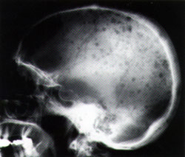

Slide 15
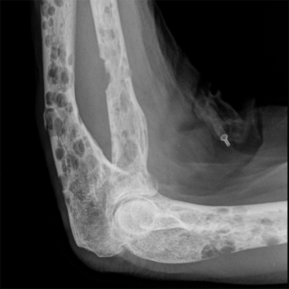

Slide 16
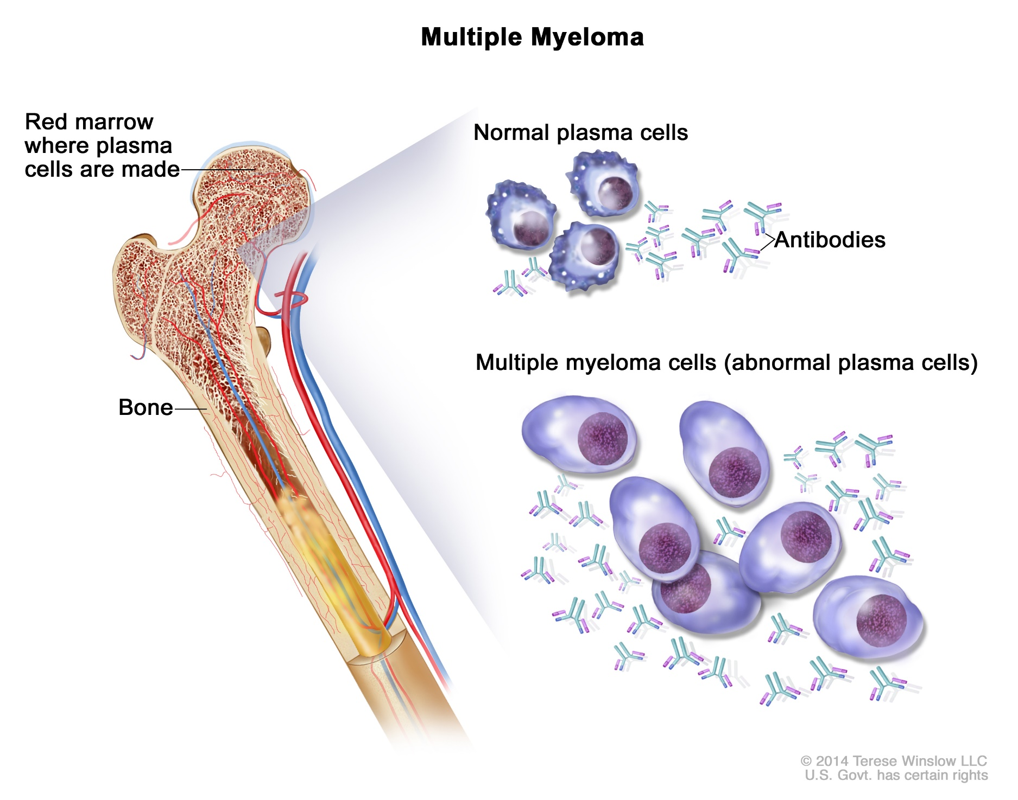

Slide 17
Grossly, the normal bone marrow is replaced by soft, gelatinous, reddish-grey tumours. The affected bone usually shows focal or diffuse osteoporosis.
Microscopically, the diagnosis of multiple myeloma can be usually established by examining bone marrow aspiration from an area of bony rarefaction.

Slide 18
i) Cellularity: There is usually hypercellularity of the bone marrow.
ii) Myeloma cells: Myeloma cells constitute >10% of the marrow cellularity.
These cells may form clumps or sheets, or may be scattered among the normal haematopoietic cells.
Myeloma cells may vary in size from small, differentiated cells resembling normal plasma cells to large, immature and undifferentiated cells.
Binucleate and multinucleate cells are sometimes present.

Slide 19
The nucleus of myeloma cell is commonly eccentric similar to plasma cells but usually lacks the cart-wheel chromatin pattern seen in classical plasma cells.
Nucleoli are frequently present.
The cytoplasm of these cells is abundant and basophilic with perinuclear halo, vacuolisation and contains Russell bodies consisting of hyaline globules composed of synthesised immunoglobulin

Slide 21
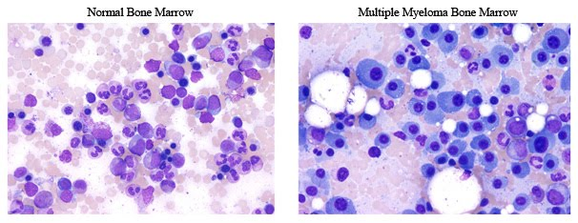

Slide 22
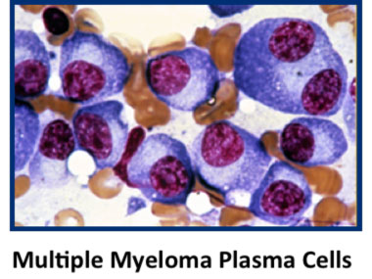

Slide 23
B. EXTRAOSSEOUS LESIONS
Late in the course of disease, lesions at several extraosseous sites become evident
2. Myeloma kidney: of light chain proteins (Bence Jones proteins) which are precipitated in the distal convoluted tubules
3. Myeloma neuropathy Infiltration of the nerve trunk roots by tumour cells produces nonspecific polyneuropathy.
4. Systemic amyloidosis
5. Liver, spleen involvement

Slide 24
Clinical Features
The clinical manifestations of myeloma result from the effects of infiltration of the bones and other organs by neoplastic plasma cells and from immunoglobulin synthesis.
1. Bone pain is the most common symptom.
The pain usually involves the back and ribs. Pathological fractures may occur causing persistent localised pain.
Bone pain results from the proliferation of tumour cells in the marrow and activation of osteoclasts which destroy the bones.

Slide 25
2. Susceptibility to infections is the next most common clinical feature.
Particularly common are bacterial infections such as pneumonias and pyelonephritis.
3. Renal failure : causes are hypercalcaemia, glomerular deposits of amyloid,
hyperuricaemia and infiltration of the kidney by myeloma cells.

Slide 26
4. Anaemia occurs in about 80% of patients of myeloma and is related to marrow replacement by the tumour cells (myelophthisis) and inhibition of haematopoiesis.
5. Bleeding tendencies may appear in some patients due to thrombocytopenia, deranged platelet function and interaction of the M component with coagulation factors.

Slide 27
6. Hyperviscosity syndrome owing to hyperglobulinaemia may produce headache, fatigue, visual disturbances and haemorrhages.
7. Neurologic symptoms occur in a minority of patients and are explained by hyperviscosity, cryoglobulins and amyloid deposits.

Slide 28
8. Biochemical abnormalities.
These include the following:
i) hypercalcaemia due to destruction of bone;
ii) hyperuricaemia from necrosis of tumour mass and from uraemia related to renal failure; and
iii) increased b-2 microglobulins and other globulins in urine and serum

Slide 29
9. POEMS syndrome is seen in about 1% cases of myeloma and includes simultaneous manifestations of polyneuropathy , organomegaly, endocrinopathy, multiple myeloma and skin changes.

Slide 30
Diagnosis
The diagnosis of myeloma is made by classic triad of features:
1. Marrow plasmacytosis of more than 10%
2. Radiologic evidence of lytic bony lesions
3. Demonstration of serum and/or urine M component.
About two-third cases of myeloma excrete Bence Jones (light chain) proteins in the urine

